Slide 1
CALCULATIONS AND ANALYSIS IN TABLEAU
James Larkin – Data Analytics Instructor

Slide 2
CALCULATIONS AND ANALYSIS IN TABLEAU
OPENING

Slide 3
CALCULATIONS AND ANALYSIS IN TABLEAU
LEARNING OBJECTIVES
After this lesson, you’ll be able to:
Create different types of calculated fields in order to analyze sample data.
Define and demonstrate how to use quick table calculations.
Apply new skills in order to analyze and visualize sample data.

Slide 4

CALCULATIONS AND ANALYSIS IN TABLEAU
Today, we will be exploring calculations in Tableau. We’ll get the chance to apply the data analytics workflow in Tableau by making business recommendations based on the Superstore data set:
Develop a hypothesis- driven approach to analysis.
Select, import, explore,
and clean data.
Structure, visualize, and complete analysis.
Make business decisions from data.
Present data-driven insights to an audience.

Slide 5


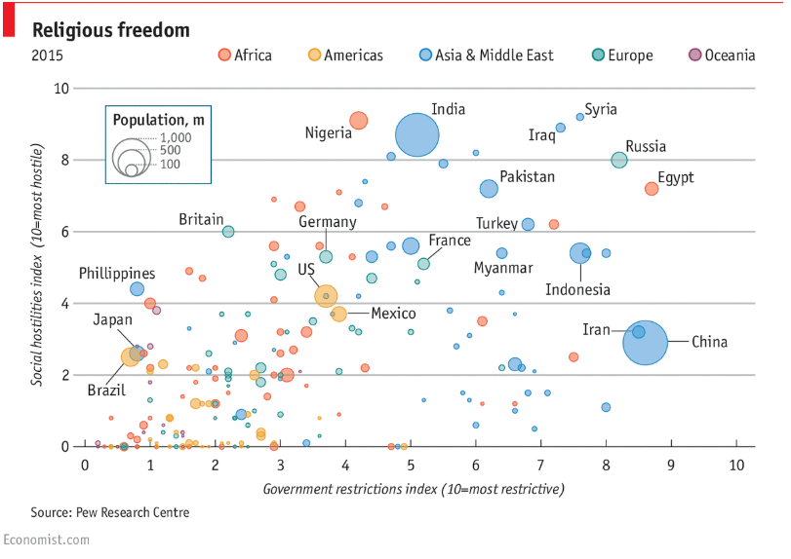
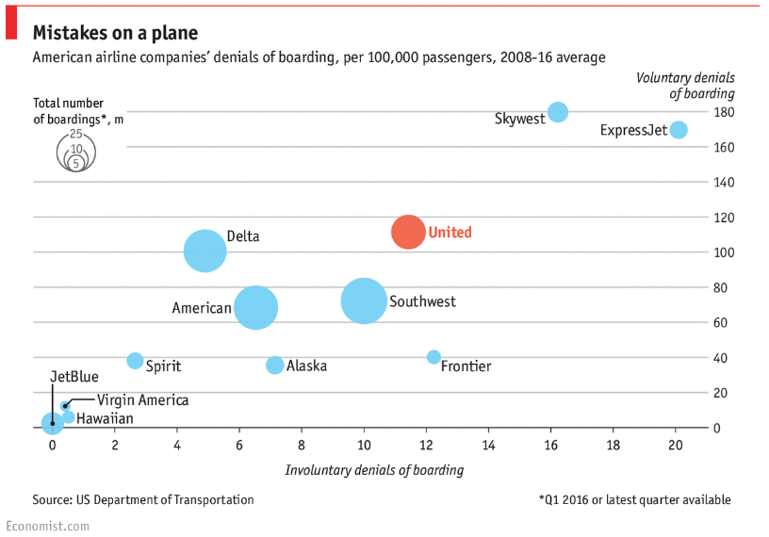
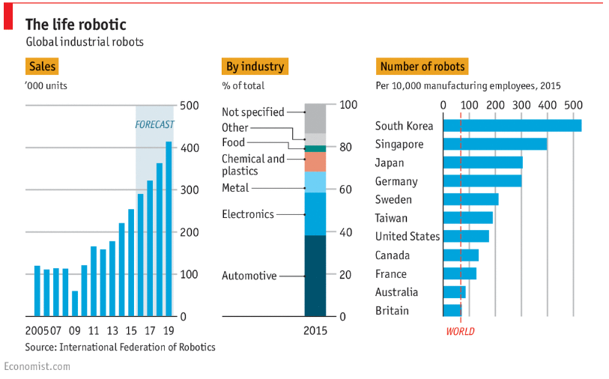
“GRAPHIC DETAIL”
Daily chart
United bumps more passengers than any other large American airline
Daily chart
Freedom of worship is on the decline Reports of religious persecution by both governments and individuals
Daily chart
America’s opioid epidemic is worsening States are losing the battle against deadly drugs like heroin and fentanyl
Daily chart
The growth of industrial robots
They mainly build cars and computer chips, for now
Source: http://www.economist.com/blogs/graphicdetail

Slide 6
CALCULATIONS AND ANALYSIS IN TABLEAU
GUIDED PRACTICE: CALCULATIONS

Slide 7
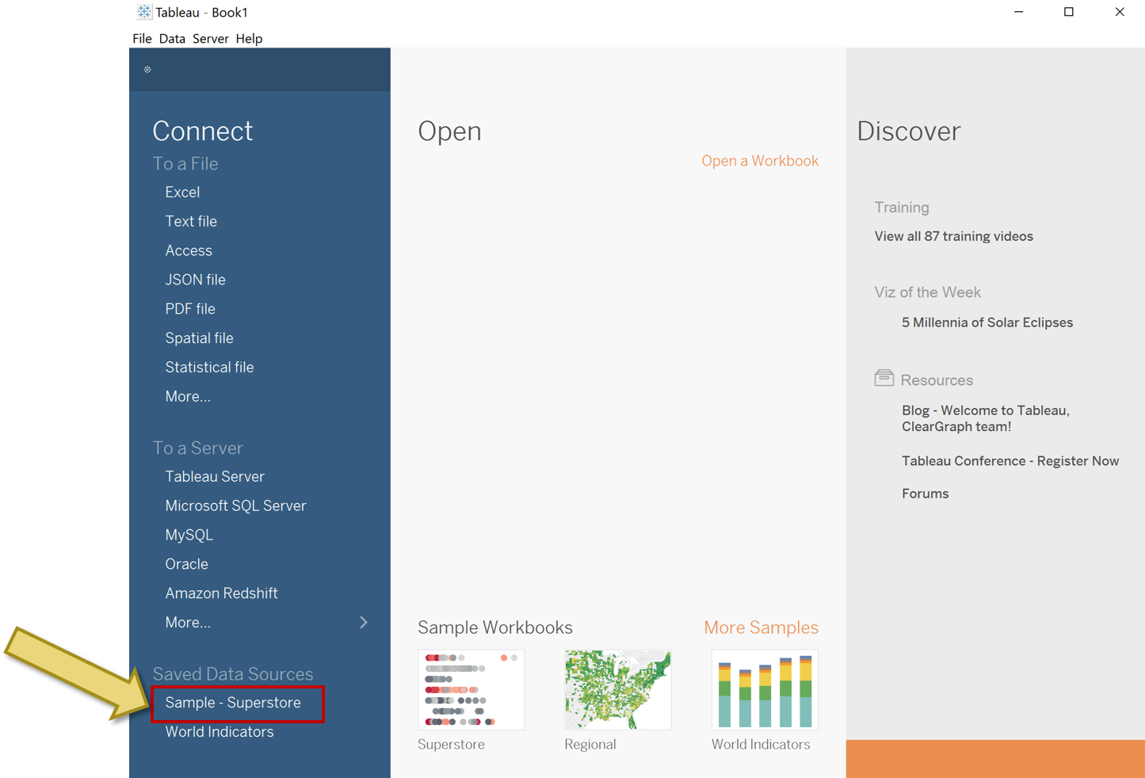
TABLEAU CALCULATIONS
For the following exercises, we’ll use the Tableau Superstore dataset, which is included in your default Tableau installation.
If you have any problems replicating the following Tableau features, you should be able to find an example using the Superstore data set.

Slide 8

TABLEAU CALCULATIONS, ANALYSIS, AND ACTIONS
Logic statements: IF, THEN, ELSE.
IF a happens, THEN return b, ELSE do c. End.
After completing its logical task, this statement ends.
independent_calculation_01:
In the Superstore data set, we have identified envelopes, labels, and fasteners as subcategories that tend to ship in smaller packages.
Categorize these three subcategories as “small items” and the rest as “large items” using IF, THEN logic.
When we work with string data for a calculation in Tableau, we’ll need to enclose them with single or double quotes — much like in SQL and Excel. Either will work in Tableau.

Slide 9
TABLEAU CALCULATIONS
Dates — DATEDIFF:
DATEDIFF( ‘datepart’, start date , end date )
Note: ‘datepart’ = ‘year’, ‘month’, ‘day’, etc.
You can find more information about DATEDIFF calculations on the Tableau help site.
independent_calculation_02:
What is the length of time, in days, that it takes for an order to ship? Create a histogram of orders by number of days to ship.
Try to translate the business question to the functions and data you have available in Tableau.

Slide 10
TABLEAU CALCULATIONS
Logic — IF THEN ELSEIF:
IF a happens, THEN return b,
ELSEIF c happens, THEN return d
END
independent_calculation_03:
How many orders were shipped slowly, at a medium pace, and quickly (slow, medium, fast)? Slow: > 4 days, medium: >2 days and <=4 days, fast: <=2 days.

Slide 11
TABLEAU CALCULATIONS
Dates – TODAY:
TODAY() is a dynamic way of returning today’s date.
Much like the TODAY() and getdate() functions in Excel and SQL, respectively, this is dynamic. When you open the workbook again in the future, TODAY() will change and affect your calculations.
independent_calculation_04:
Considering today's date, how many months has it been since each item shipped?

Slide 12
TABLEAU CALCULATIONS
Aggregate vs. row level:
Measure/measure.
SUM(measure)/SUM(measure).
independent_calculation_05:
What is the profit ratio for each subcategory (i.e., profit/sales)?

Slide 13
TABLEAU CALCULATIONS
Aggregate and logic:
IF the aggregate of a is true, THEN return b.
independent_calculation_06:
Which subcategories are doing good, OK, and poorly? Good: >.3, OK: <= . 3 and >0, bad: <= 0.
Is this calculation running at the row level or at an aggregate level (before or after the GROUP BY)?

Slide 14
TABLEAU CALCULATIONS
Dates – DATEPART:
DATEPART( ‘datepart’, date )
independent_calculation_07:
Does it take longer to ship items that were ordered on the weekend?
Categorize order dates by weekdays and weekends using a DATEPART calculation.

Slide 15
TABLEAU CALCULATIONS
Parameters:
A parameter is a data point that is not in the data set. It’s an outside input.
These are especially useful for when consumers of your reports interact with them. They can change inputs and see how they will affect results.
For example: “What are our sales if they are increased by n percent?’
In this case, sales is our data set and n is the parameter.
independent_calculation_08:
How will profits change by subcategory if we were to increase them by n percent?

Slide 16
CALCULATIONS AND ANALYSIS IN TABLEAU
DEMO: CALCULATED
FIELDS AND TABLE CALCULATIONS

Slide 17
CALCULATION FIELD: GRANULARITY AND AGGREGATION
What is the difference between the following calculated field formulas, assuming we are trying to determine net profit?
Profit ratio = [PROFIT]/[SALES]
Profit ratio = SUM([PROFIT])/SUM([SALES])
Sales | Profit | Profit Ratio
$100 | 15 | 15%
10 | 5 | 50%
50 | 20 | 40%
100 | 30 | 30%
 |  | 135% | When we sum each row first:
$260 | $ 70 | 27% | When we sum column first:
incorrect.
correct.
Notes:
Instructor Note:
Explanation:
Here are four line items, each with a value for profit and sales.
Profit ratio is typically calculated as profit over sales.
If we drag the field into Tableau, it will automatically assume and generate an aggregate of SUM(Profit Ratio), summing up .15 + .50 +.40 +.30, which misrepresents our desired numeric goal.
Instead, we need to sum the columns first (just like in Excel) so that Tableau calculates 70 for total profit and 260 for total sales, then performs division to provide the correct overall net-profit ratio.
Pro tip: At times, you may want profit/sales, but this would not be aggregated with a SUM function. An example might be the average net-profit ratio per row. If so, the appropriate aggregation would be AVG (profit ratio) to provide the correct calculation.
Resource: See Tableau video on granularity and aggregation: https://goo.gl/y6WuaV.

Slide 18
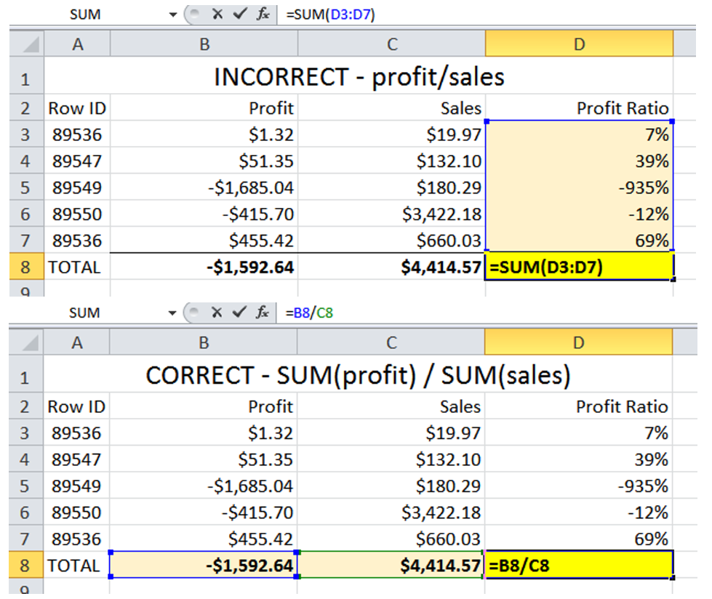
CALCULATION FIELD: GRANULARITY AND AGGREGATION
Here’s an illustration using Excel calculations:
Notes:
Explanation:
Here are four line items, each with a value for profit and sales.
Profit ratio is typically calculated as profit over sales.
If we drag the field into Tableau, it will automatically assume and generate an aggregate of SUM(Profit Ratio), summing up .15 + .50 +.40 +.30, which misrepresents our desired numeric goal.
Instead, we need to sum the columns first (just like in Excel) so that Tableau calculates 70 for total profit and 260 for total sales, then performs division to provide the correct overall net-profit ratio.
Pro tip: At times, you may want profit/sales, but this would not be aggregated with a SUM function. An example might be the average net-profit ratio per row. If so, the appropriate aggregation would be AVG (profit ratio) to provide the correct calculation.
Resource: See Tableau video on granularity and aggregation: https://goo.gl/y6WuaV.

Slide 19
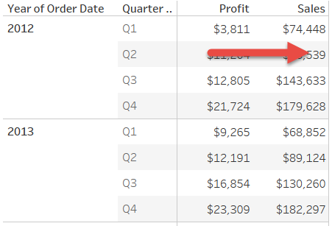
TABLE CALCULATIONS
A regular calculation, such as profit/sales, runs across raw data.

Slide 20
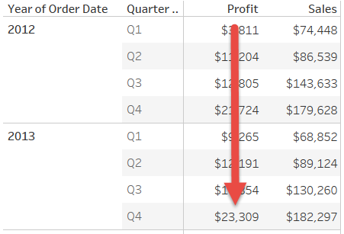
TABLE CALCULATIONS
A table calculation, such as year-over-year profit growth, runs down a single column of raw data.

Slide 21
CALCULATIONS AND ANALYSIS IN TABLEAU
GUIDED PRACTICE: TABLE CALCULATIONS

Slide 22
TABLE CALCULATIONS
Table calculations can be added to any measure in the Tableau view by right clicking and selecting “Quick Table Calculation.”
When right clicking the created table calculation, the “Compute Using” option allows us to specify how to use that table calculation.
Now, use the Guided Practice tabs to answer the table calculation questions.

Slide 23
CALCULATIONS AND ANALYSIS IN TABLEAU
INDEPENDENT PRACTICE: ANALYZE DATA

Slide 24

ACTIVITY: ANALYZE DATA (USING EXCEL)
: PART 1
In Excel, take five minutes to review the “story of one row” and prepare a few hypotheses for the Superstore data set.
Consider these questions:
Which product categories or subcategories are not doing well?
Can a product be a problem even if it has high sales?
How should we define underperforming products?
If a product is not performing well but has a large market share (lots of customers), is it worth keeping?
Share your hypotheses with the class.

Slide 25

ACTIVITY: ANALYZE DATA (USING TABLEAU)
: PART 2
Take a few minutes to build Tableau visualizations and/or dashboards that answer these questions.
Using your initial hypotheses, validate initial answers to:
Which product categories or subcategories are not doing well?
Can a product be a problem even if it has high sales?
How should we define underperforming products?
If a product is not performing well but a has large market share (lots of customers), is it worth keeping?
Share your insights (and relative time/effort required)!

Slide 26
CALCULATIONS AND ANALYSIS IN TABLEAU
CONCLUSION

Slide 27
REVIEW: CALCULATIONS AND ANALYSIS IN TABLEAU
RECAP
In today’s lesson, we learned how to:
Create logic, aggregation, and date calculated fields to analyze data
Define the procedures and order of operations for table calculations.
Apply our calculations to the Superstore data set in order to answer real world questions.

Slide 28
CALCULATIONS AND ANALYSIS IN TABLEAU

Slide 29
CALCULATIONS AND ANALYSIS IN TABLEAU
RESOURCES

Slide 30
CALCULATIONS AND ANALYSIS IN TABLEAU
RESOURCES
Additional Examples of Calculated Fields (Interworks): https://www.interworks.com/blog/ccapitula/2015/03/24/tableau-essentials-calculated-fields-introduction
Differences Between Calculated Fields and Table Calculations: https://www.thedataschool.co.uk/elena-caric/difference-table-calculations-calculated-fields/
Example: Descriptive and Inferential Analysis Dashboard Using Superstore Data Set: https://www.ryansleeper.com/super-sample-superstore/

